Slide 1
Editors, Webmasters, and Historians
K E Y C L U B
Workshop Presented by:
Rasmi Elasmar
District Technology Editor
Mark Ubongen
District New Editor
DCON 2013

Slide 2
K E Y C L U B
What is a Bulletin Editor?
Promoters of Key Club
Most creative officer position
The news central of the club
DCON 2013

Slide 3
K E Y C L U B
What do Bulletin Editors do?
Create newsletters
Submit Articles and Visuals to cnhkeyclub.org
Design flyers and posters
Take pictures
Manage a club website (optional)
Publicize Key Club around your school and your community!
Websites and newsletters make it easy to share meeting dates, event dates, ideas, awards, scholarships, birthdays, division news, and more with your fellow members!
DCON 2013

Slide 4
K E Y C L U B
What do Historians do?
Take MORE pictures at events and meetings.
Create a scrapbook that contains anything relevant to the current year:
Separate it into these categories: Service to School, Service to Community, Fundraising Projects, Assistance to Kiwanis Projects, Major Emphasis Involvement, Miscellaneous
Submit it by next DCON!
Traditional = book form
Non-traditional = ferris wheel
DCON 2013

Slide 5
K E Y C L U B
Taking Pictures: The Right Way
Always have a camera ready at every event
If not, improvise! Cellphone cameras are decent nowadays.
At a club level, you can take any type of pictures, but focus on service!
At a district level, you must take pictures of service.
For the next slide, say whether it’s appropriate or not.
DCON 2013

Slide 6
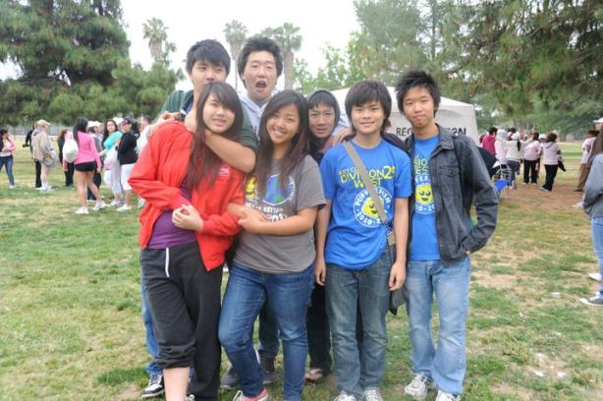
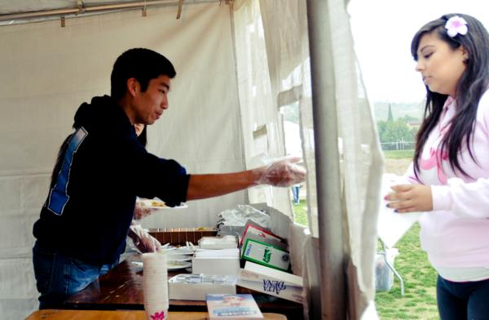
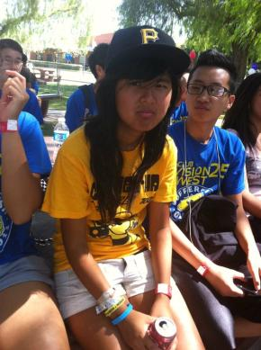
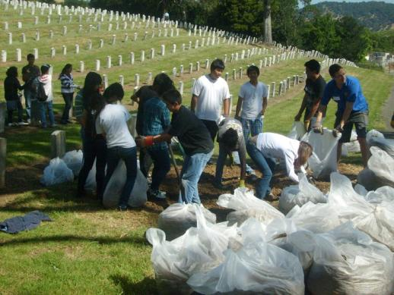
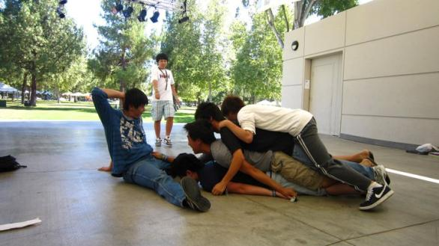
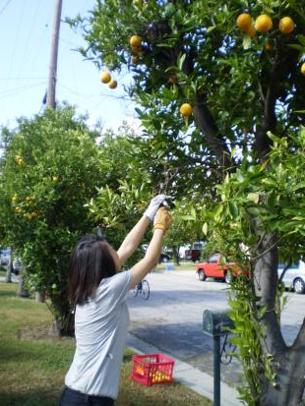
K E Y C L U B
Is it appropriate?
-Picture courtesy of D35E
-Picture courtesy of D8
DCON 2013

Slide 7
K E Y C L U B
I have pictures, what now?
You can now send your pictures to your respective Lt. Governor and Division News Editor.
Keep the images to a minimum. Choose 5 of your best photos per event and make sure the file size is reasonable!
Your Lt. Governor will filter them and send them to the district. Your Division News Editor will use them in the division newsletters.
The district needs all photos and newsletters by the 20th of every month so turn in your pictures every 10th of the month!
DCON 2013

Slide 8
K E Y C L U B
Articles
Did you go to a fun Key Club event and want to write about your experience? Want to be heard all across the entire California-Nevada-Hawaii District?
Submit one online at cnhkeyclub.org
Write an article using the template found on the CNH Website (cnhkeyclub.org) under News>CNH District Newsletter and email it to cnharticle@gmail.com
Visuals at cnhvisuals@gmail.com
Be sure to put D## [School] – [Topic] as your subject line and D##_[Initials]_[MonthDigits] as your filename.
Anyone can write an article.
DCON 2013

Slide 9
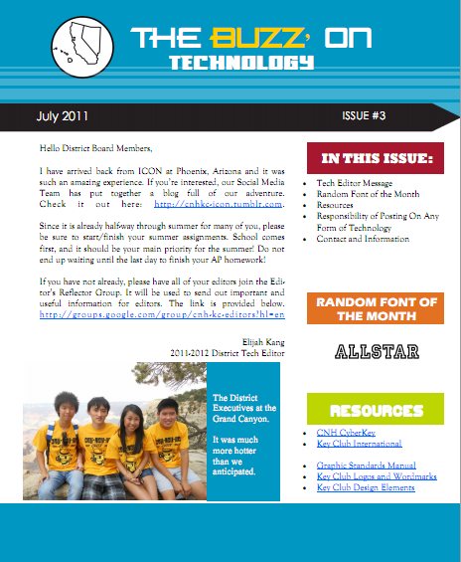
K E Y C L U B
Newsletters
A newsletter is generally a news magazine that keeps your club members updated on Key Club
You can incorporate more than just news, such as upcoming events or member of the month or even useful tips!
Newsletters should follow the Graphic Standards
DCON 2013

Slide 10
K E Y C L U B
Optional Contests
There are many contests available for bulletin editors
Club Newsletter
Poster (Digital and Handmade)
Key Club promotion video
Club Website
Interested? See the guidelines from last year’s applications on the CNH Website under Recognition>Contests.
DCON 2013

Slide 11
K E Y C L U B
Resources
http://www.cnhkeyclub.org
http://www.keyclub.org
Copy of the Graphic Standards Manual http://bit.ly/graphicstandardsmanual
Club Editor Duties Guideline http://bit.ly/editorduties
Editor’s Reflector http://groups.google.com/group/cnh-kc-editors
DCON 2013

Slide 12
CNH | KEY CLUB
Graphics
DCON 2013

Slide 13
Graphic Standards
CNH | KEY CLUB
Century Gothic for headers
Goudy Old Style for body text
Alternatives fonts include Verdana, Myriad Pro, Arial, and more!
Use accent fonts to add your own style!
There are plenty of fantastic font resources online – stay tuned!
Always use the appropriate Key Club Logo, pencil, fonts, colors, and CNH logo
All logos and word marks must remain proportional.
Find the whole guide on the CyberKey under Resources!
DCON 2013

Slide 14
Graphic Standards
CNH | KEY CLUB
There should be nothing within a half inch of all sides of the Key Club logo and watermark.
The logo should also be on a neutral background
See the Graphic Standards manual on the CyberKey under Resources>Graphics
DCON 2013

Slide 15
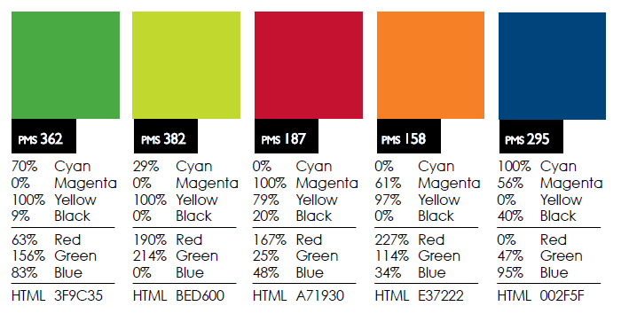
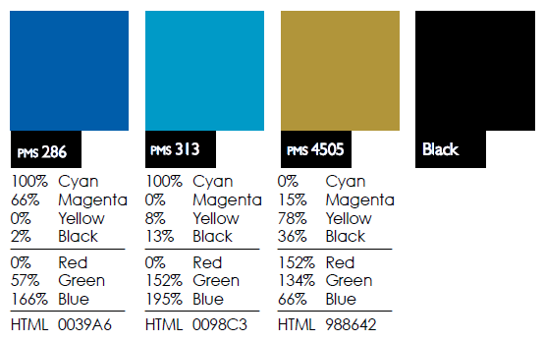
Graphic Standards
CNH | KEY CLUB
Colors to use in all Key Club material
DCON 2013

Slide 16
Earlier-promised font-related goodness
CNH | KEY CLUB
Finding fonts online
fontsquirrel.com
dafont.com
losttype.com
google.com/webfonts
theleagueofmoveabletype.com
DCON 2013

Slide 17
Programs
CNH | KEY CLUB
Of course, there is Photoshop.
Ridiculously expensive.
GIMP
Paint.NET
Inkscape
pixlr.com’s online editor
Aviary “Phoenix” online editor
DCON 2013

Slide 18
CNH | KEY CLUB
Social Networking
DCON 2013

Slide 19
CNH | KEY CLUB
“Rasmi, what are you doing? We already know how to use Facebook and Twitter.”
DCON 2013

Slide 20
CNH | KEY CLUB
… but wait, there’s more!
DCON 2013

Slide 21
CNH | KEY CLUB
Twitter
DCON 2013

Slide 22
Making an account
CNH | KEY CLUB
Choose a simple, meaningful username.
@D99Nbees
Make a really, really strong password.
Try to generate a random string of characters.
Memorize it. Give it to no one.
To transfer accounts, change the password to something else, then transfer the account and change the email and phone number listed under Account Settings.
DCON 2013

Slide 23
Purpose
CNH | KEY CLUB
Remind people about everything.
Events, meetings.
Dues that need to be paid.
Fundraisers
Keep people updated and keep in touch easily.
DCON 2013

Slide 24
CNH | KEY CLUB
“Rasmi, stop being silly. Facbook does all of this already.”
DCON 2013

Slide 25
CNH | KEY CLUB
No really, there’s more.
DCON 2013

Slide 26
Mass text messaging
CNH | KEY CLUB
People can opt to receive your tweets via text message
All they need is a phone with a texting plan.
No data plan.
No Twitter account.
Text Follow D99Nbees to 40404
Update anyone from any computer or smartphone.
You can use your phone, too – just add your phone number under Account Settings > Mobile.
DCON 2013

Slide 27
More on usage…
CNH | KEY CLUB
Update people often.
Keep your account secure.
Be aware of your audience.
This is public on the web – don’t post anything that you wouldn’t want your mother to see.
DCON 2013

Slide 28
CNH | KEY CLUB
Facebook
DCON 2013

Slide 29
Purpose
CNH | KEY CLUB
Again, Facebook is good for mass-announcements.
Event invitations and reminders.
Polls.
Sharing photos – submit these to Mark, too!
Don’t use Facebook for serious business.
Remember, your name is still attached to your Facebook account.
DCON 2013

Slide 30
General management
CNH | KEY CLUB
You should be the sole administrator of your group.
No need to worry about which email address controls which group – group control is easily transferrable to different people (if you’re in charge).
Also send information out via email for those who don’t have Facebook (your advisors, perhaps).
DCON 2013

Slide 31
CNH | KEY CLUB
Questions?
Rasmi Elasmar
cnhkc.dte1213@gmail.com
Mark Ubongen
cnhkc.dne@gmail.com
DCON 2013

